Slide 1
Surface area and volume

Slide 2
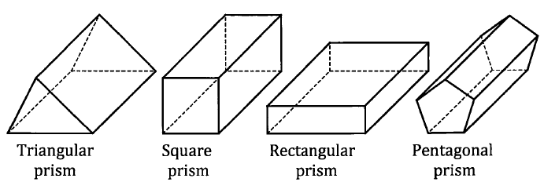
Prism – surface area
Surface area a prism = sum of the area of all the surfaces

Slide 3
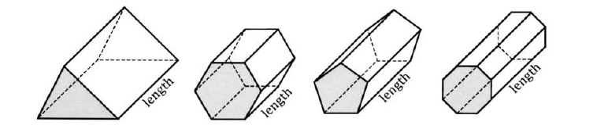
Prism – volume
Volume of a prism = area of uniform cross section * length

Slide 4
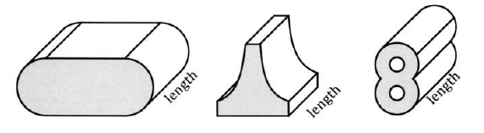
Other shapes with uniform cross section
Volume = area of uniform cross section * length

Slide 5

Cylinder
Surface area = 2$π$r² ⁺ 2$π$r(h)
Volume = $π$r²h
Notes:
http://www.mathsteacher.com.au/year9/ch14_measurement/15_total/cylinder.htm

Slide 6
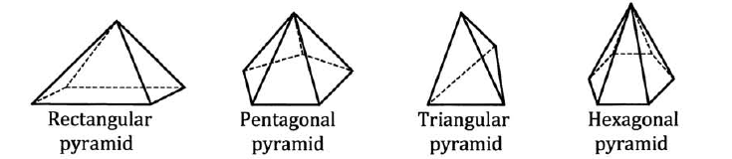
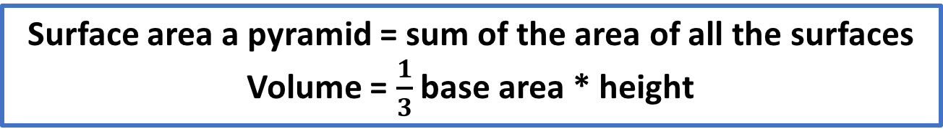
Pyramid – Surface area and volume
Surface area a pyramid = sum of the area of all the surfaces
Volume = $\frac{1}{3}$ base area * height

Slide 7
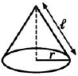
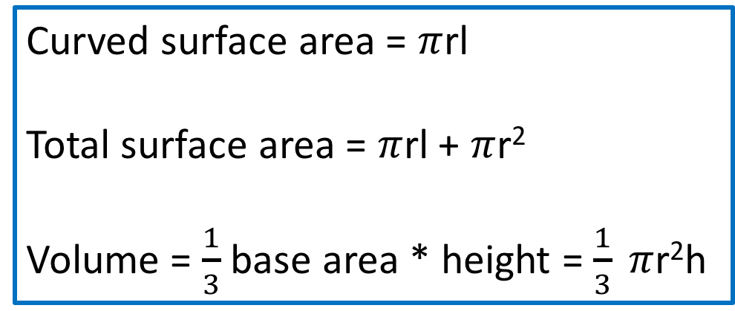
Cone – surface area & volume
Curved surface area = $π$rl
Total surface area = $π$rl + $π$r²
Volume = $\frac{1}{3}$ base area * height = $\frac{1}{3} π$r²h
h

Slide 8
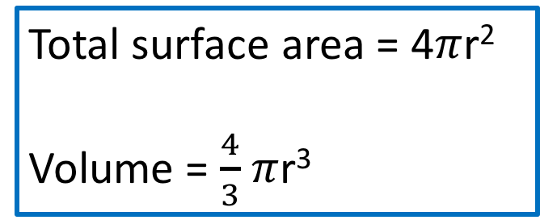
Sphere – surface area & volume
Total surface area = 4$π$r²
Volume = $\frac{4}{3}$ $π$r³
Notes:
https://img.clipartfest.com/a65b40c78dec844d5063ecbf09805943_34654262-sphere-volume_300-281.jpeg

Slide 9
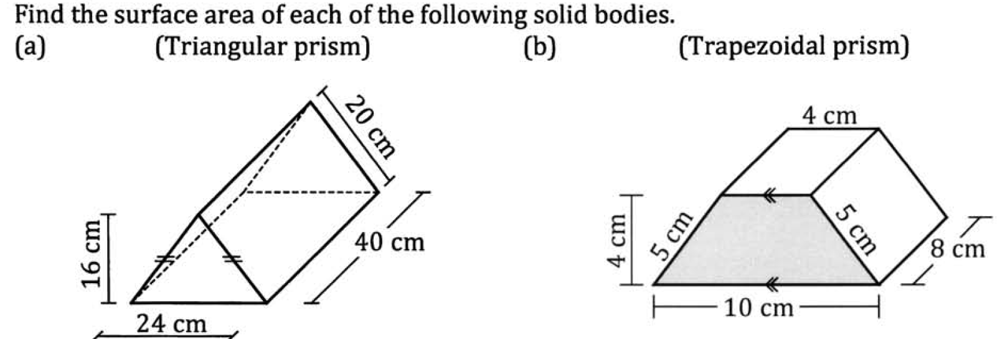

Slide 10
